Slide 1
English grade 3
Stand up!
Unit 6
Lesson 1
Teacher: Ms Thom

Slide 2
Vocabulary

Slide 3
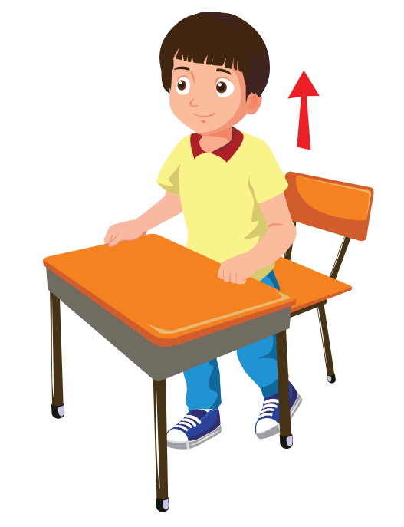
English 3
Vocabulary
Stand up

Slide 4
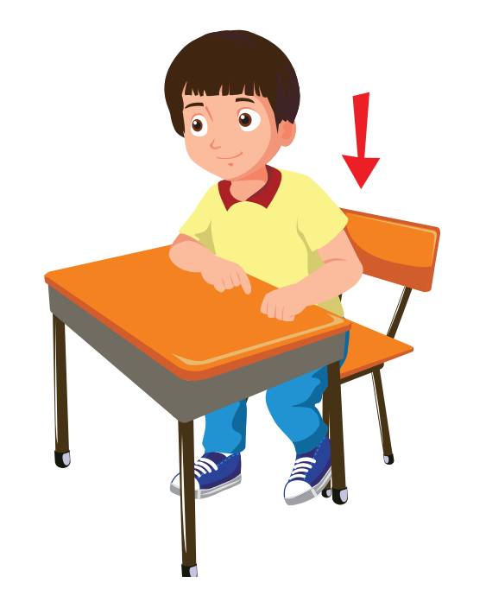
English 3
Vocabulary
Sit down

Slide 5
English 3
Vocabulary
Be quiet
Don’t talk

Slide 6
English 3
Vocabulary
Open your book

Slide 7
English 3
Vocabulary
Close your book

Slide 8
structure

Slide 9
1. Look, listen and repeat.

Slide 10
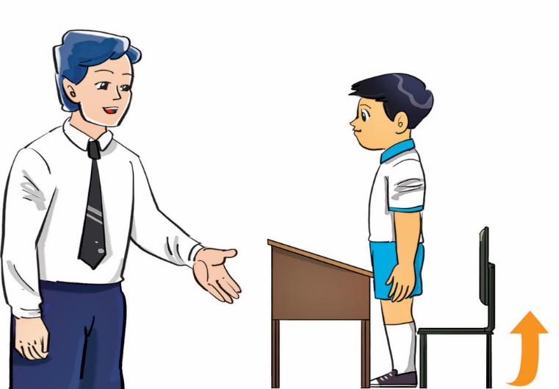
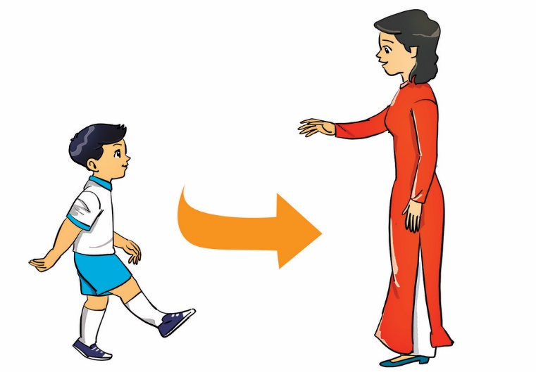
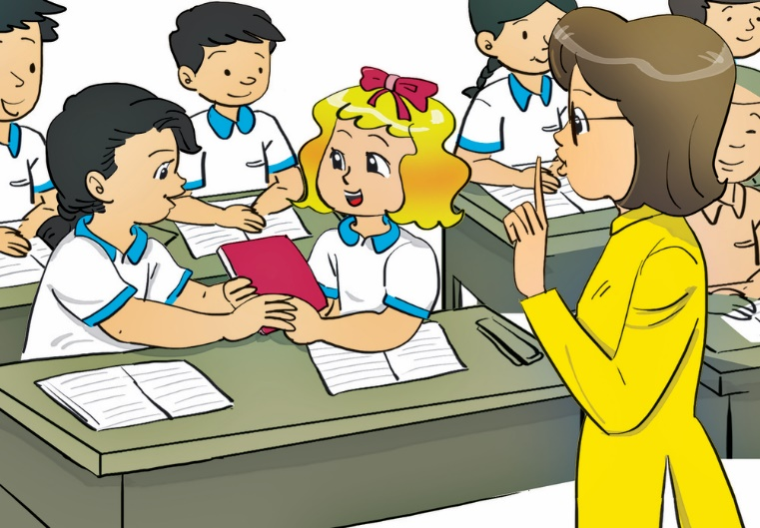
2. Point, say and do the actions.
Stand up!
Come here!
Don’t talk!
Open your book!
Close your book!

Slide 11
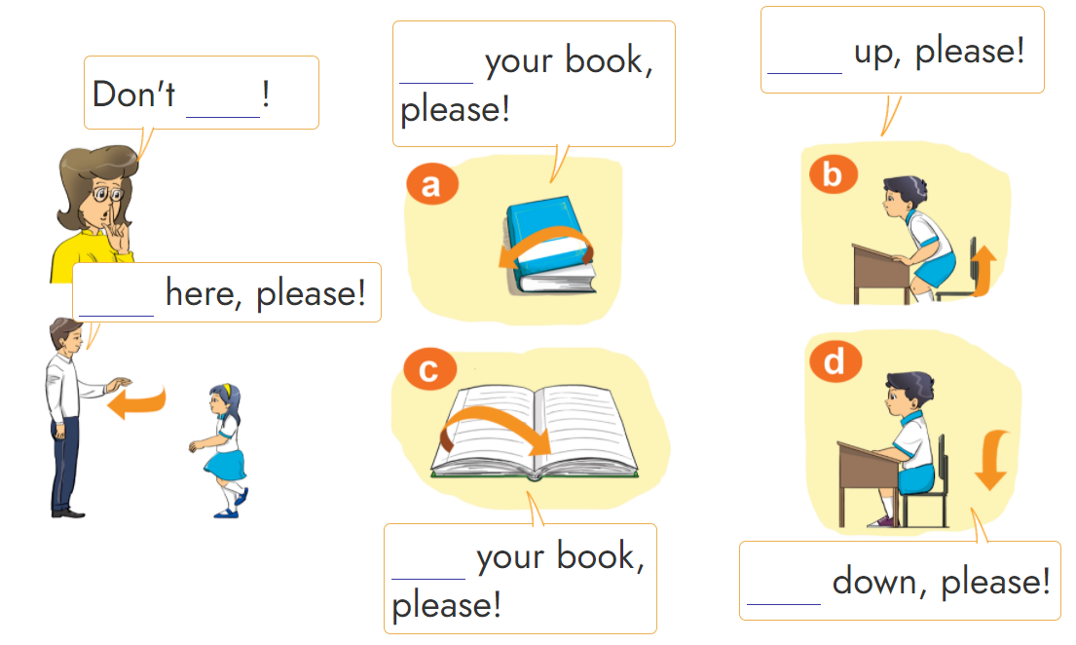
3. Let's talk.
Open
Stand
talk
Come
Close
Sit

Slide 12
Notes:
Ms Huyền Phạm - 0936.082.789 – YOUTUBE: MsPham. Facebook: Dạy và học cùng công nghệ.

Slide 13
Câu hỏi 3
Stand up, please.
Open your book, please.
+5
-1
-1
-1
Come here, please.
Close your book, please.
Notes:
Ms Huyền Phạm - 0936.082.789 – YOUTUBE: MsPham. Facebook: Dạy và học cùng công nghệ.

Slide 14
Câu hỏi 2
Stand up, please.
Open your book, please.
+5
-1
-1
-1
Don’t talk!
Come here, please.
Notes:
Ms Huyền Phạm - 0936.082.789 – YOUTUBE: MsPham. Facebook: Dạy và học cùng công nghệ.

Slide 15
Câu hỏi 1
Close your book, please.
Open your book, please.
+5
-1
-1
-1
Be quiet, please.
Don’t talk!
Notes:
Ms Huyền Phạm - 0936.082.789 – YOUTUBE: MsPham. Facebook: Dạy và học cùng công nghệ.

Slide 16
Câu hỏi 4
Be quiet, please.
Sit down, please.
+5
-1
-1
-1
Come here, please.
Stand up, please.
Notes:
Ms Huyền Phạm - 0936.082.789 – YOUTUBE: MsPham. Facebook: Dạy và học cùng công nghệ.

Slide 17
Câu hỏi 3
Be quiet, please.
Come here, please.
+5
-1
-1
-1
Sit down, please.
Come in, please.
Notes:
Ms Huyền Phạm - 0936.082.789 – YOUTUBE: MsPham. Facebook: Dạy và học cùng công nghệ.

Slide 18
Câu hỏi 2
Sit down, please.
Come here, please.
+5
-1
-1
-1
Be quiet, please.
Close your book, please.
Notes:
Ms Huyền Phạm - 0936.082.789 – YOUTUBE: MsPham. Facebook: Dạy và học cùng công nghệ.

Slide 19
Câu hỏi 1
Sit down, please.
Be quiet, please.
+5
-1
-1
-1
Close your book, please.
Stand up, please.
Notes:
Ms Huyền Phạm - 0936.082.789 – YOUTUBE: MsPham. Facebook: Dạy và học cùng công nghệ.

Slide 20
Great job!
Exit
8
13
Notes:
Ms Huyền Phạm - 0936.082.789 – YOUTUBE: MsPham. Facebook: Dạy và học cùng công nghệ.

Slide 21
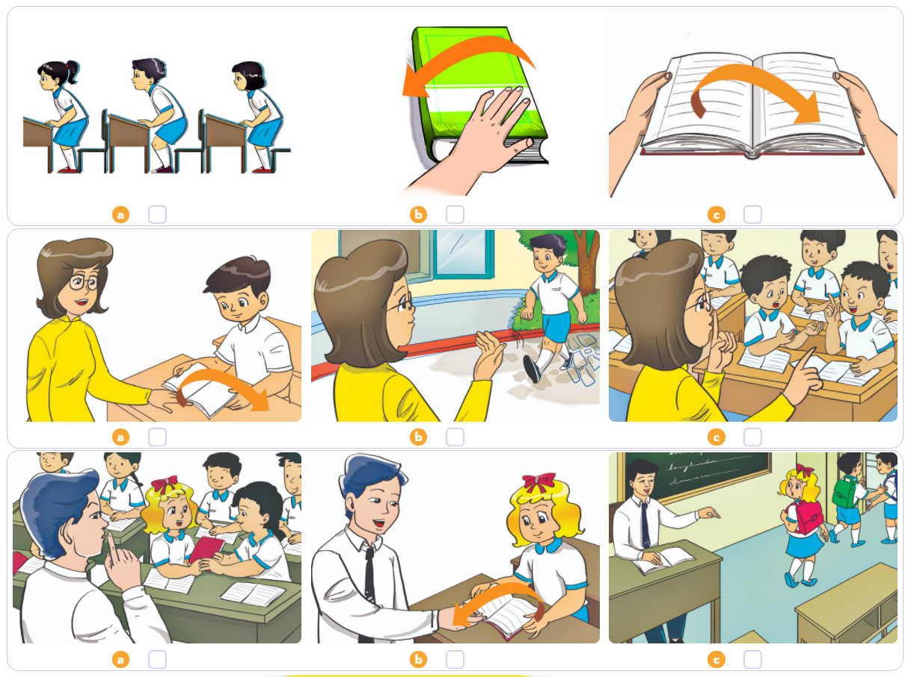
4. Listen and tick.
1
2
3

Slide 22
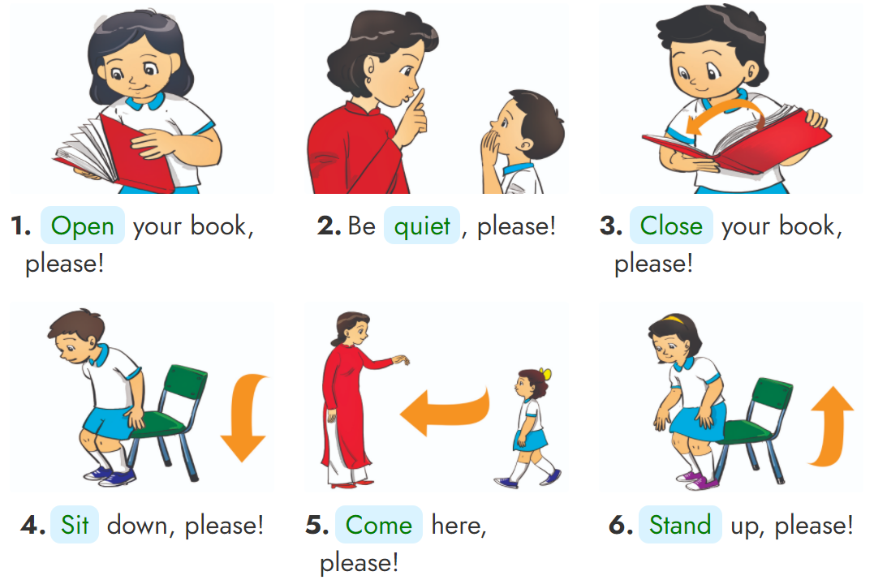
5. Look and write.
______
____
____
___
______
______

Slide 23
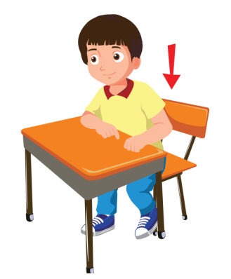
English 3
Structure
_______, please!
Open
your book
Stand up
Be quiet
Close your book
Sit down

Slide 24
THANK YOU!
Welcome to join with me!

